Slide 1

Welcome to Guruji Astro
Data analysis of guruji Astro Dataset

Slide 2
Tasks #**Task 1: Data Exploration** #1. Load the dataset into your preferred data analysis tool (e.g., Python, R, Excel). #2. Check for missing values in the dataset and handle them appropriately. #3. Provide summary statistics for key numeric columns (e.g., Charge, TalkTime). #4. Visualize the distribution of call charges using a histogram. n

Slide 3
Inserting thew data with the help of pandas read_csv command
Describe keyword Usally help to overview the summary

Slide 4
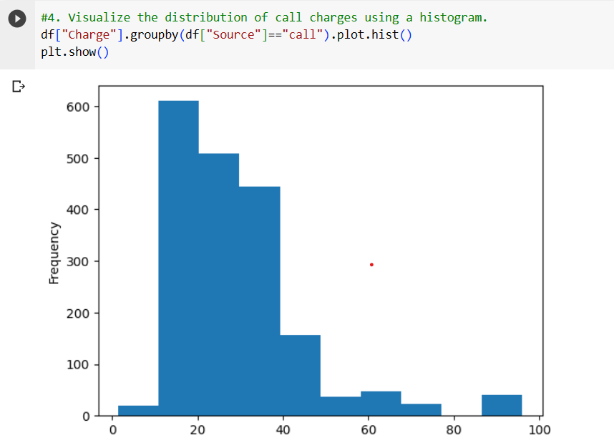
You can usally understand with this data that as per this we can understand guruji Astro app gives free call for certain minutes for user
After that they charge so at some sudden point the charge has been than after it is gradually coming to down side

Slide 5
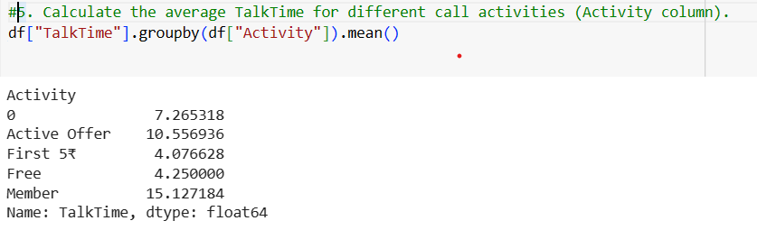
You can see guys average talktime for different call activites ,we can see the active offer have highest mean of member are having highest talktime and low are the FREE user,s usually it happens ..

Slide 6
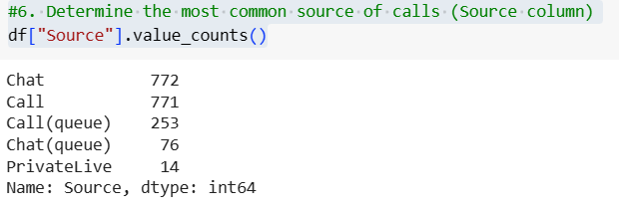
You can observe I have used the value count function for it where it shows like common source of contact is chat and least is privatelive
This busy world had made social media active

Slide 7
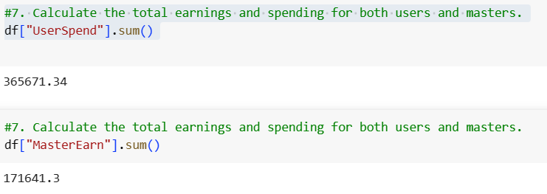
we can easily find about earnings and spending of the user and master
And one thing you all can observe its apropriatly half of the user spent .

Slide 8
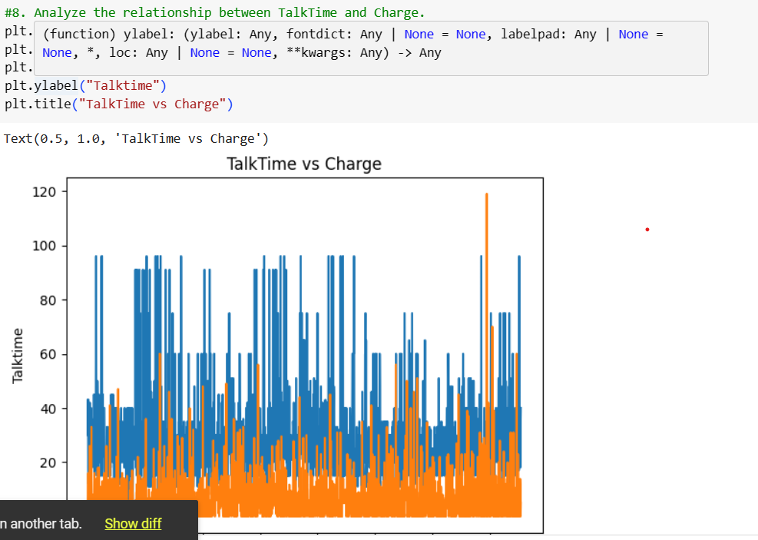
You can observe the linear releation in charge and talktime
As charge increase than usually talktime increase

Slide 9
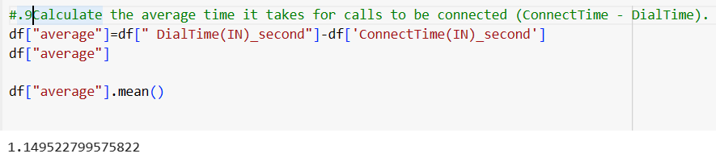
Here I made the dailtime and connect time into second than I found to easy to work with it as I substracted the value and I have dane ac

Slide 10
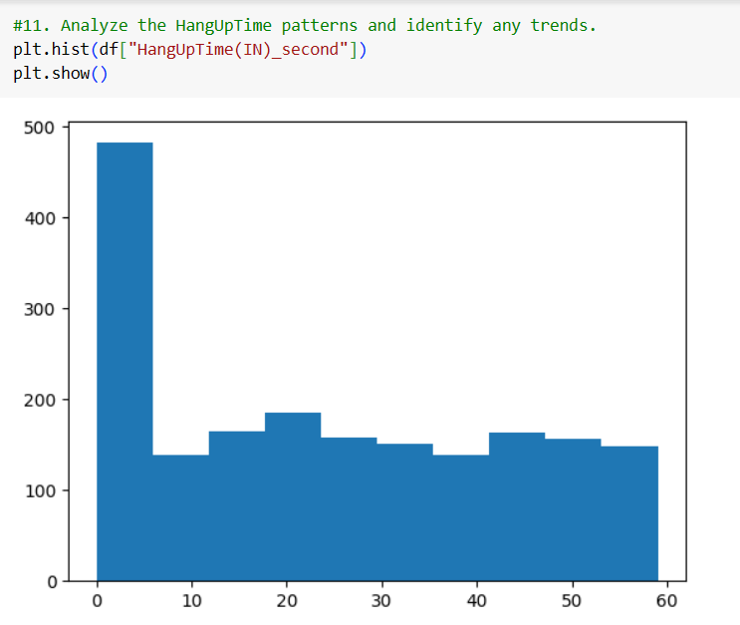
Guys you can see here the first five the minutes are free so things are high till the time after certain time you can observe the growth full down side

Slide 11
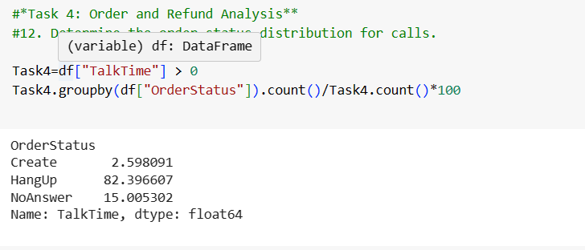
Order status distribution of calls
I took talk time > 0(“ I have puted nan values as 0”)
And made group by orderstatus count divide by total count * 100
So by the mean the percentage of hangups are 82% hard reason for the loss

Slide 12
Order status distribution of calls
I took talk time > 0(“ I have puted nan values as 0”)
And made group by orderstatus count divide by total count * 100
So by the mean the percentage of hangups are 82% hard reason for the loss

Slide 13
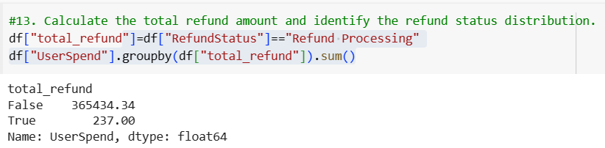
You can see the total refund has been for the catageory refund processing
I have userspend time with it I have grouped the total refund in this the total amount of refund we need to pay is 237

Slide 14
INSIGHTS
Large number of user are doing call for free {here going loss}
Around large number of people are paying less amount
Call and chat are good to be prefered for communication
Good point compare to no refund the refund guys are too less

Slide 15

ThankYou

